Slide 1
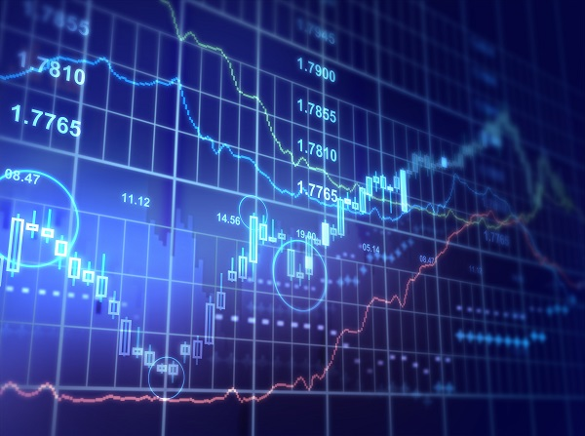
Stock Price Analytics
Davis, Arjun, Jack, Jason, and Nico

Slide 2
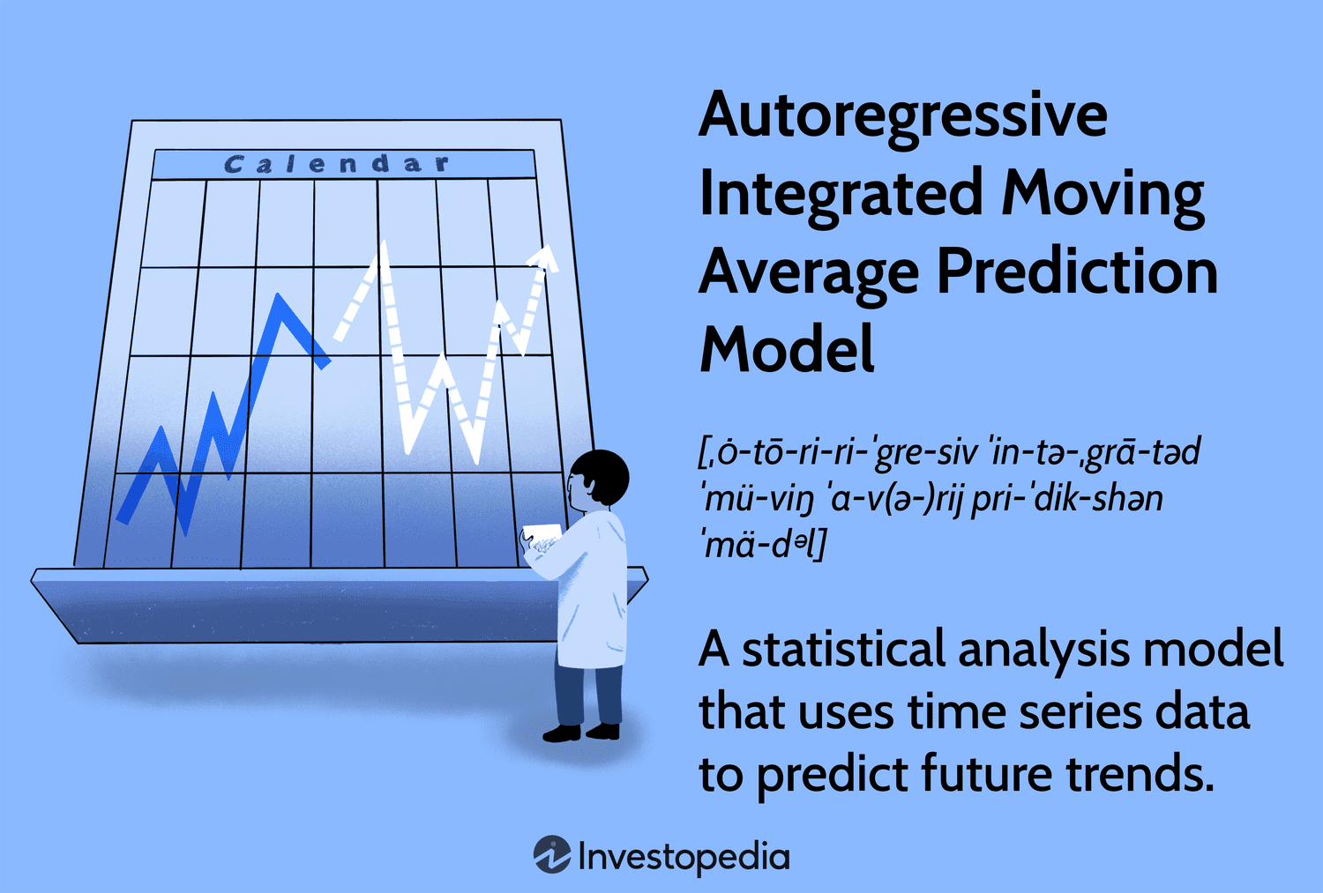
Overview of Original Model
ARIMA (Autoregressive Integrated Moving Average)
Autoregressive:
Relies on past patterns
Integrated:
Takes the differences between data points
Helps to remove noise from trends → More accurate predictions
Moving averages:
Uses Errors to improve itself

Slide 3
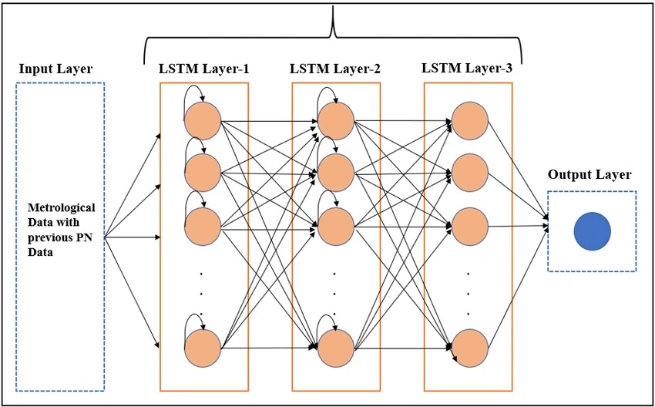
Enhancements and benefits: ARIMA → LSTM
LSTM: Long Short Term Memory
ARIMA: Mainly for linear patterns and simple relationships
LSTM: Handles more complex, non-linear data, over longer periods of time
In conclusion, ARIMA is good for predicting simpler data while LSTM is able to handle more complex data
Notes:
LSTM: Long Short Term Memory
ARIMA: Mainly for linear patterns and simple relationships
Can outperform LSTM models SOMETIMES but, mainly when the data is constant over time, and if the data has some underlying linear relationships.
LSTM: Handles more complex, non-linear data, over longer periods of time
Better recognizing long term patterns
It is able to learn “on its own”, without the need of manual feature engineering
For example, when you use an ARIMA model, you need to manually tune the models parameters (p,d,q) which is why we did not use an ARIMA model for our stock predictions.
In conclusion, ARIMA is good for predicting simpler data while LSTM is able to handle more complex data

Slide 4
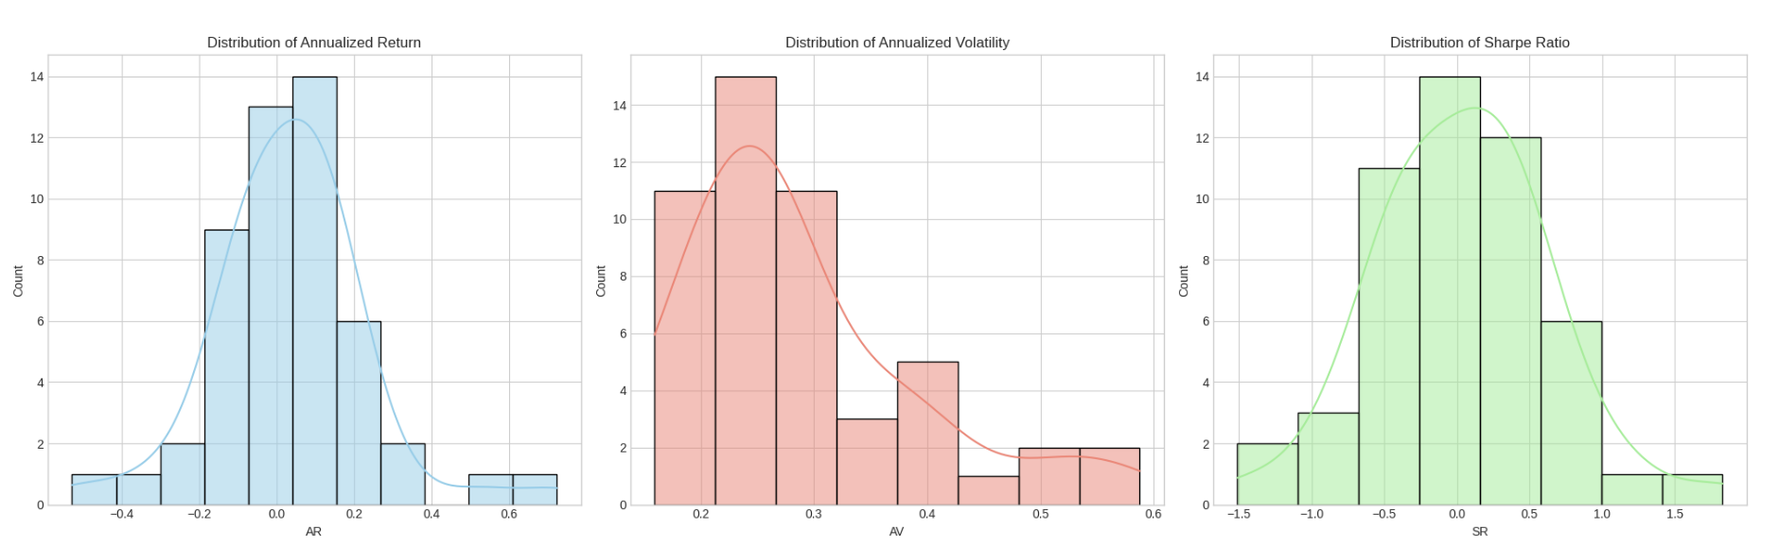
Findings: Part 1
AR (Annualized Return) → Predicts Average Yearly Profit/Loss
AV (Annualized Volatility) → Predicts Volatility(how much price fluctuates)
SR (Sharpe Ratio) → Reward vs. Risk

Slide 5
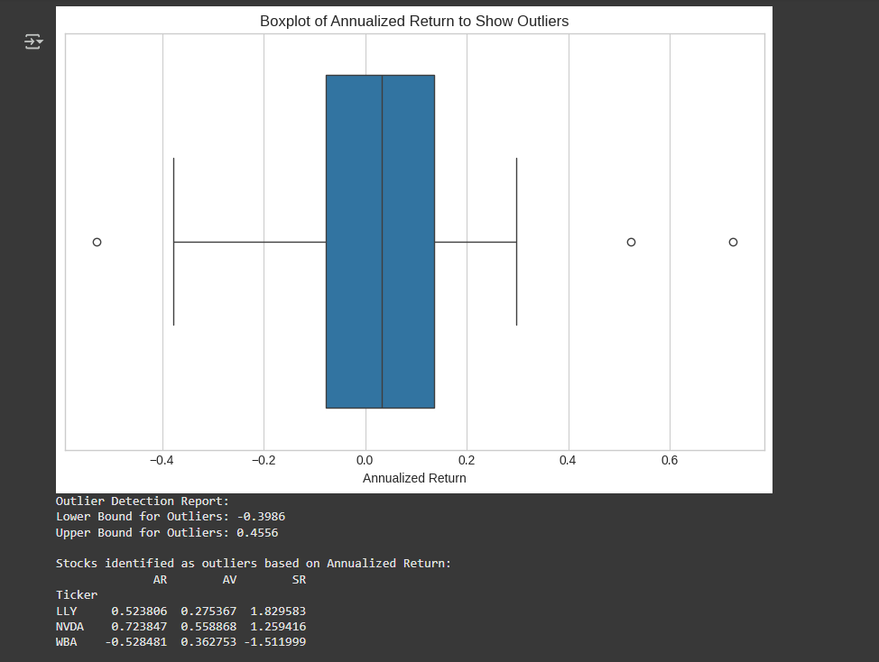
Findings: Part 2
Outliers: We created a box plot to show the potential outliers in the data set. We found the outliers to be LLY, NVDA, and WBA

Slide 6
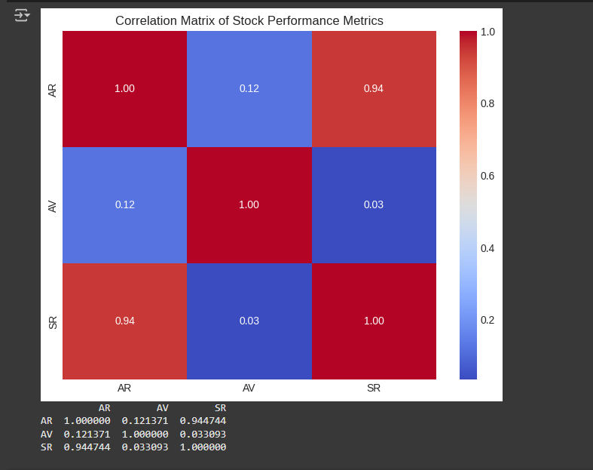
Findings: Part 2
Correlation Matrix: Here is the heat map between our different metrics (AR, AV, SR)
Notes:
Here is the heat map between our different metrics (Annualized Return, Annualized Volatility, Sharpe Ratio), we see that Annualized Return is heavily correlated with the Sharpe Ratio
(as AR goes up, SR goes up)
We can also see that Annualized Volatility not very correlated with the other metrics, with it all being below 0.15

Slide 7
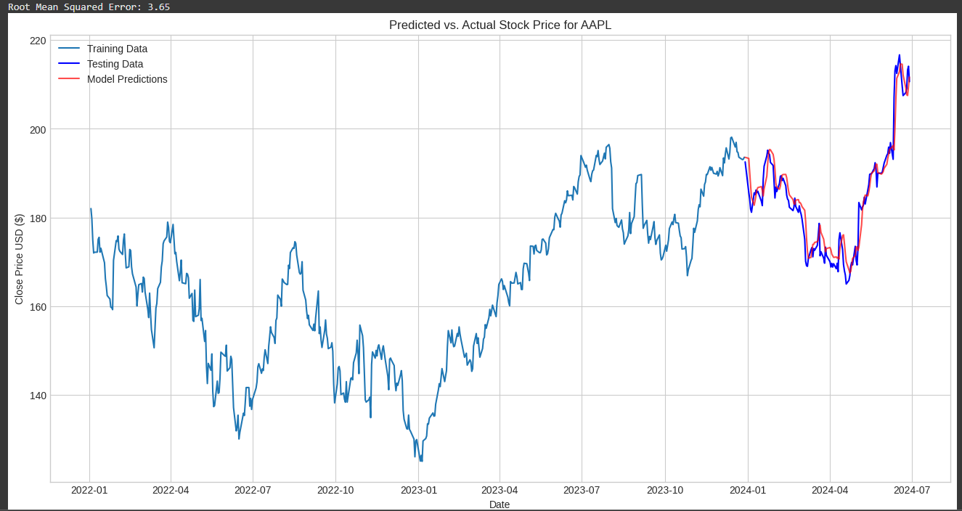
Findings: Part 2
Notes:
Here is the visualization for our LSTM model. We used a train-test split, where we did 80% of the data to be training data and 20% of the data to be testing data. The training data is the light blue and the testing data is the dark blue. We see that the models predictions(the red data) are very close and accuracy predict the correct overall structure of the graph, meaning that this model would be good to help you determine when to invest. Alongside this visualization, we can look at the Root Mean Squared Error(RMSE) which is also very low at a score of 3.65, also telling us that our model is a good fit.

Slide 8
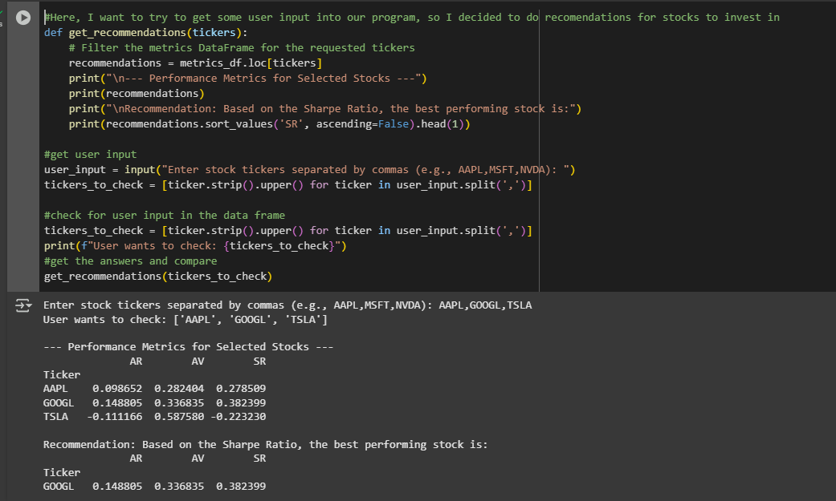
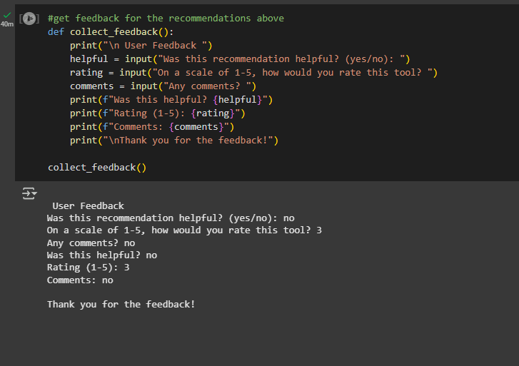
User Interaction:
After getting a recommendation, users could say if it was helpful or not, give it a rating, or leave a comment.
Over time, the model could learn from that input to personalize or improve future suggestions.
Comments can also be used to decide new features to add to the model or visualizations.
Notes:
For user interaction, users can say whether if it was helpful or not, and leave a comment. The model can use this learn to personalize its recommendations, and learn from it to improve future suggestions. Comments can also be used to decide new features to add to the model or visualizations.

Slide 9
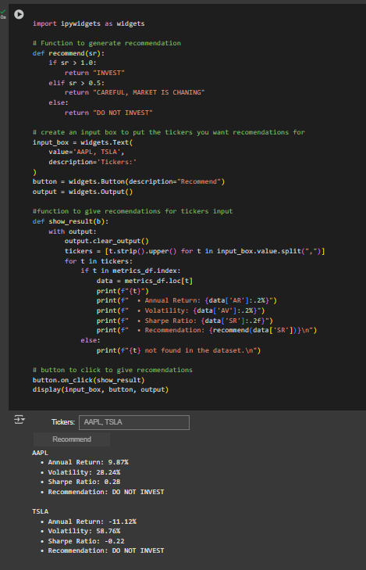
Innovation
Add UI elements for better user interaction instead of it being in the console.
Depending on Sharpe Ratio(For user input, send a message(hold, sell, etc) based on Sharpe Ratio.

Slide 10
Future Enhancements
Better data(ex. More data, more relevant information, etc)
Financial data such as Moving Averages would be an example of a form of data that could be added to help the model have more information on things that can affect stock prices
Train the model on past data and test to see if it can predict the most recent data instead of a train-test split like we did
Explore more advanced architectures and models other than LSTMs such as GRUs(similar performance, less training)
Time based features such as holidays, day of the week, what month, etc
Add features like real-time updates
Could have the model learn from the current actual data and compare it to its predictions to have it learn

